Slide 1
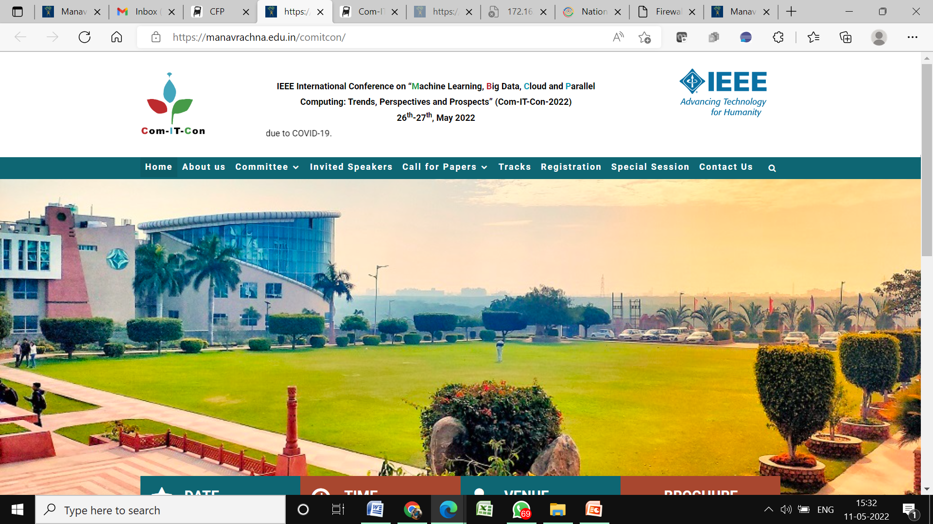

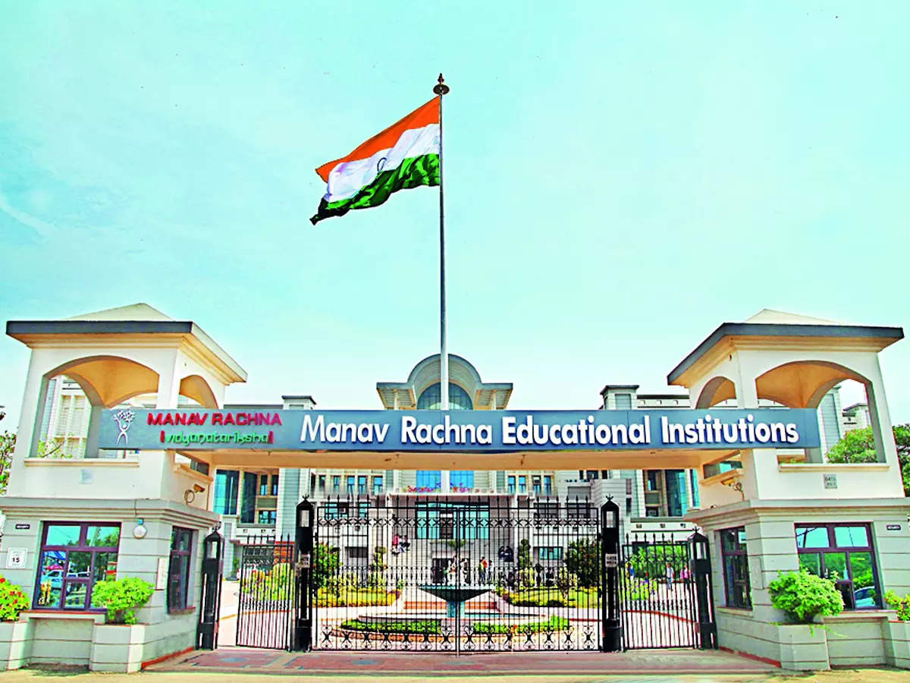
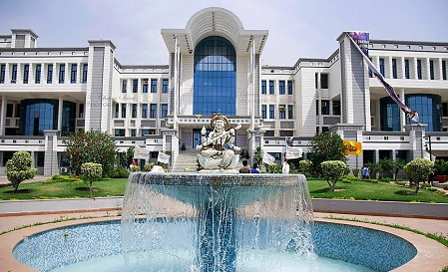
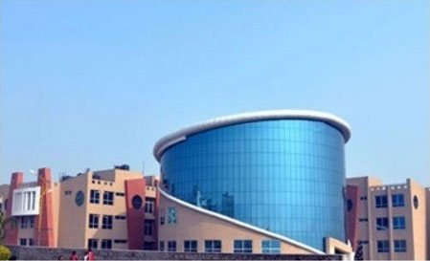
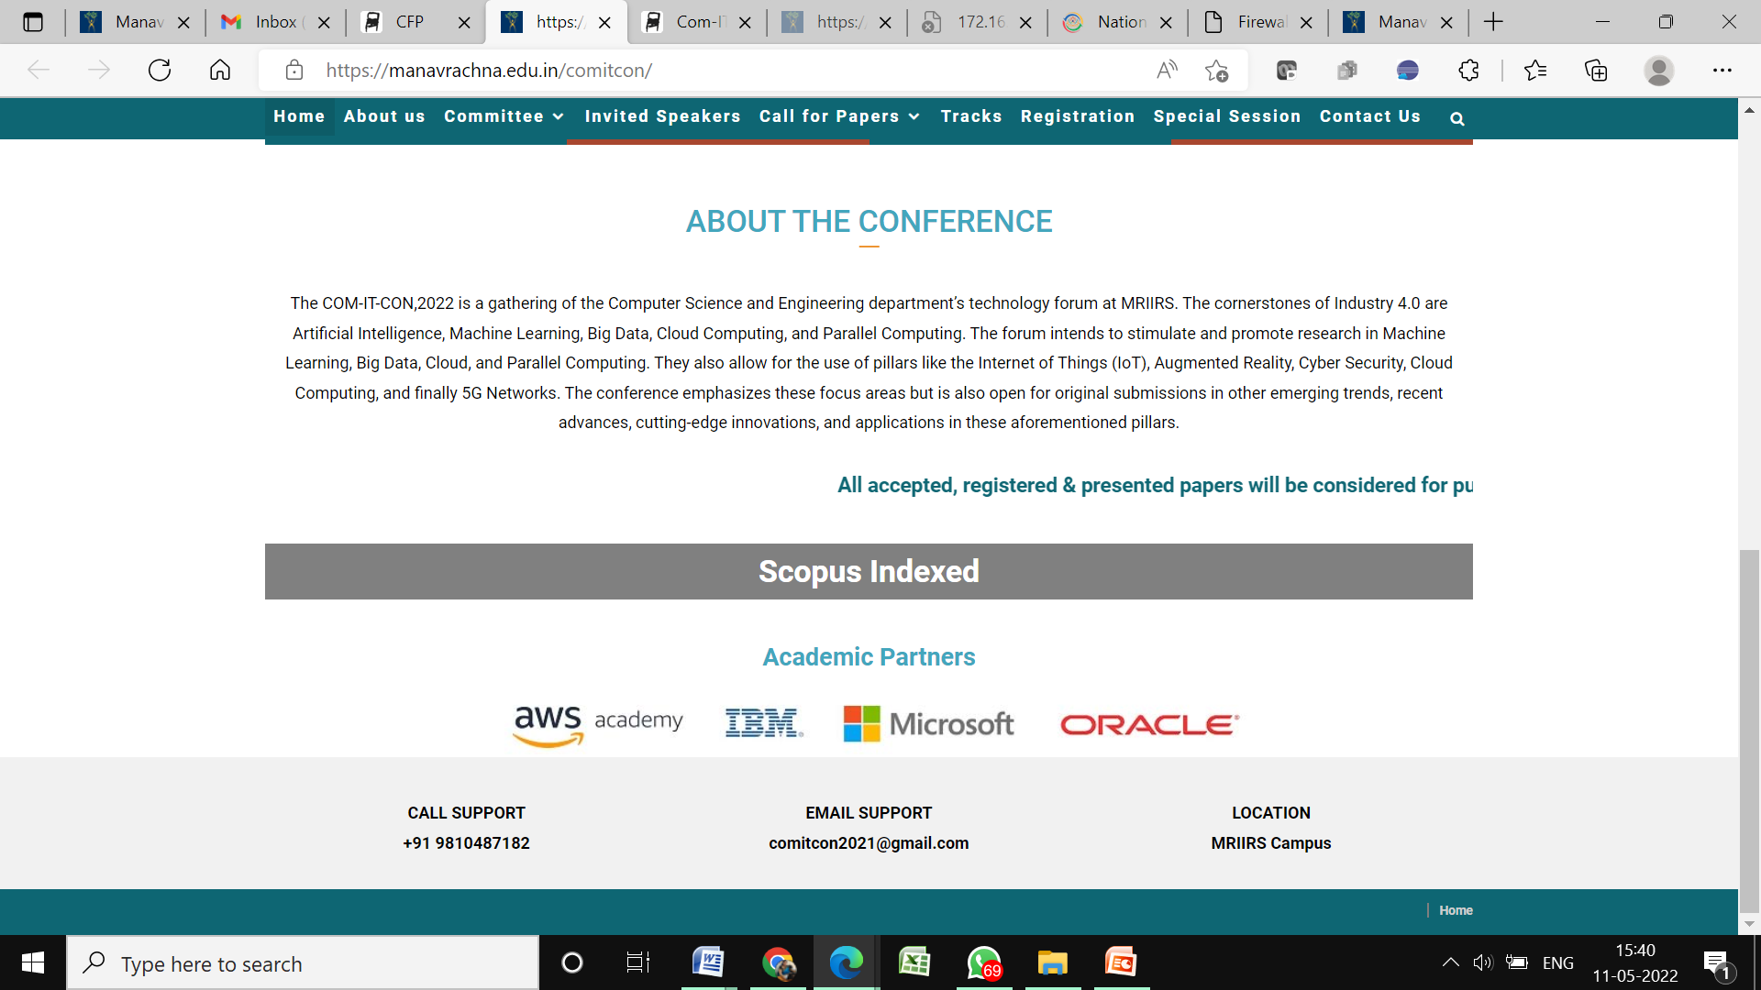


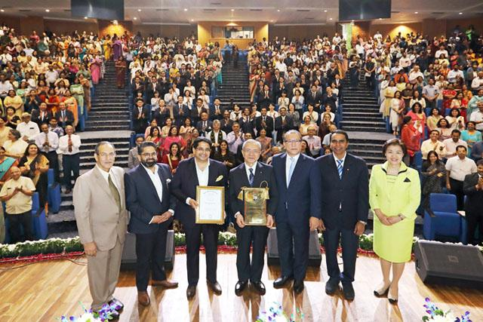
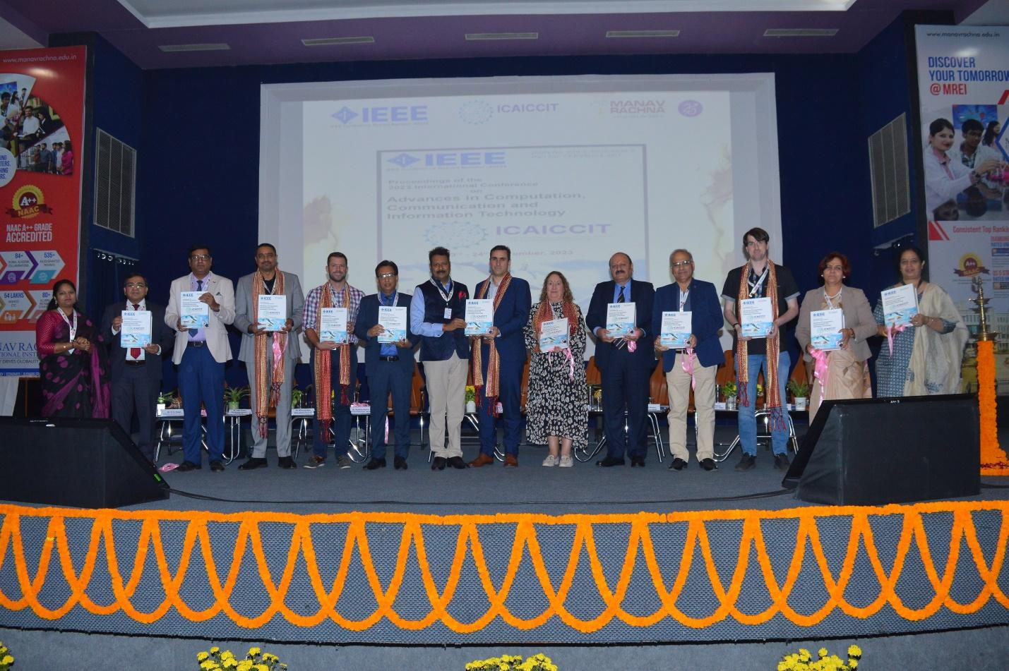
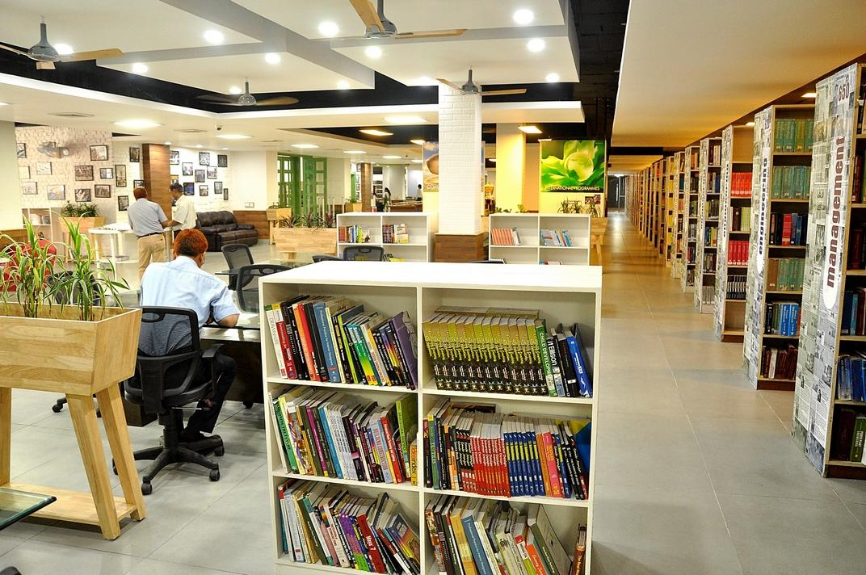
ICAICCIT-2025, 3rd International conference on Advances in Computing, Communication and Information Technology, technically Co-Sponsored by IEEE Delhi SECTION (IEEE record no # 68829)
on 31st Oct & 1st Nov. 2025

Slide 2
Performance-Driven Text Classification on
MovieLens-100K Using FLAN-T5 and BART
Paper id:579
Presented by
A.Jagadeesh
Authors Name & Affiliation

Slide 3
Index-
Introduction
Problem Statements
Objectives
Literature Review
Methodology
Result & Discussion
Conclusion & Future Scope
References

Slide 4
Introduction:
Movie recommendation systems help users find relevant content.
Traditional methods like collaborative filtering face issues such as cold-start, sparsity, and
lack of context.
Large Language Models (LLMs) improve understanding of text through semantic analysis.
This study uses FLAN-T5 and BART on the MovieLens-100K dataset for genre prediction.
The framework combines summary generation, zero-shot classification, and LIME-based
explanations for better accuracy and transparency.

Slide 5
Problem Statements:
Traditional recommendation systems depend on user history and metadata.
They face cold-start and data sparsity problems.
Lack of contextual understanding reduces recommendation quality.
Most models offer low interpretability — users can’t see why items are recommended.
There is a need for an accurate and explainable text-based framework using transformer
models to improve genre prediction and recommendations.

Slide 6
Objectives:
Develop a text classification framework for movie genre prediction.
Use FLAN-T5 to generate concise movie summaries.
Apply BART for zero-shot genre classification.
Improve accuracy and reduce dependency on user history.
Enhance model interpretability using LIME explanations.
Demonstrate the strength of transformer-based NLP models in sparse-text scenarios.

Slide 7
Literature Review:
Existing Research:
Earlier methods like collaborative filtering and CNN/RNN models improved accuracy but
required large datasets.
Hybrid and graph-based models captured complex user–item relations but faced scalability
issues.
Transformer-based models introduced context awareness and semantic understanding in
recommendations.
Few studies explored text-based inputs (e.g., subtitles or summaries) with zero-shot learning.
This work bridges that gap using FLAN-T5 and BART for genre prediction with better
performance and interpretability.

Slide 8
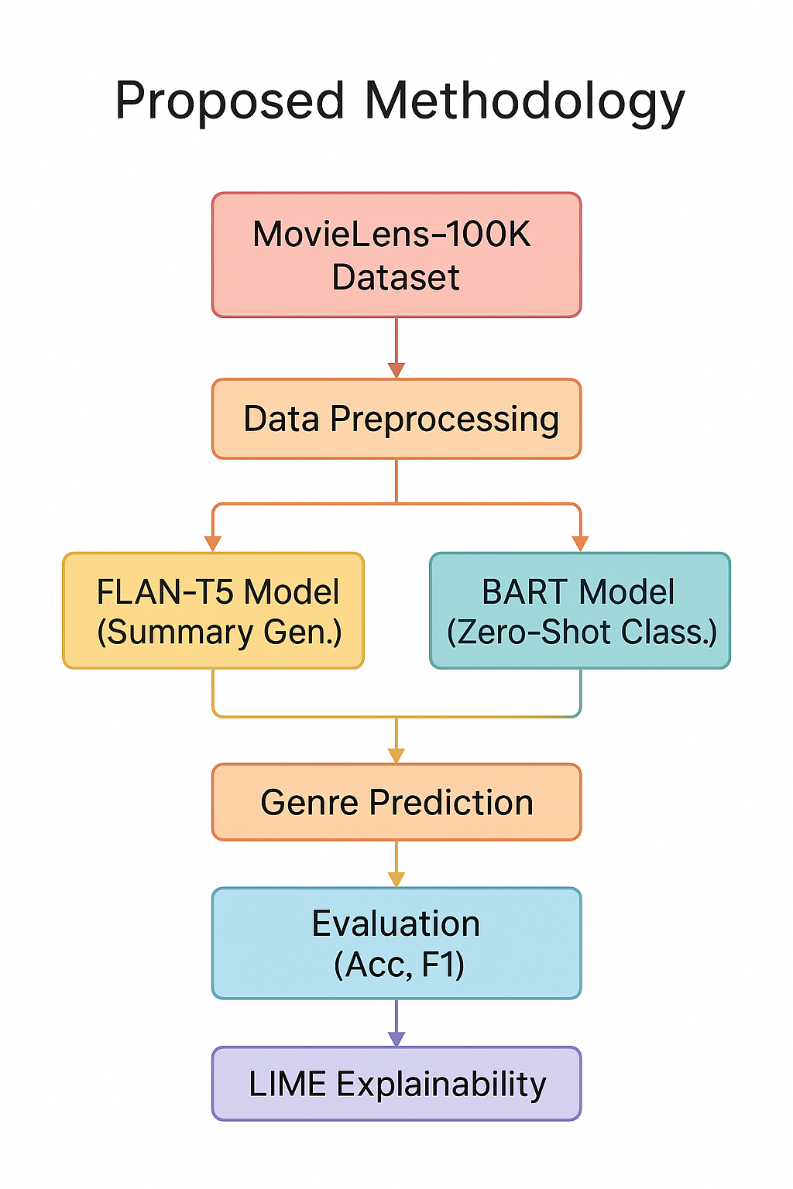
Methodology:
Pipeline Overview:
1. Dataset: MovieLens-100K, containing movie titles, genres,
and user tags.
2. Data preprocessing – cleaning, text normalization, and
tokenization.
3. FLAN-T5 generates movie summaries from textual data.
4. BART performs zero-shot genre classification on generated
summaries.
5. Results compared using accuracy, precision, recall, and F1-
score.
6. LIME provides explanations for model predictions to ensure
transparency.

Slide 9
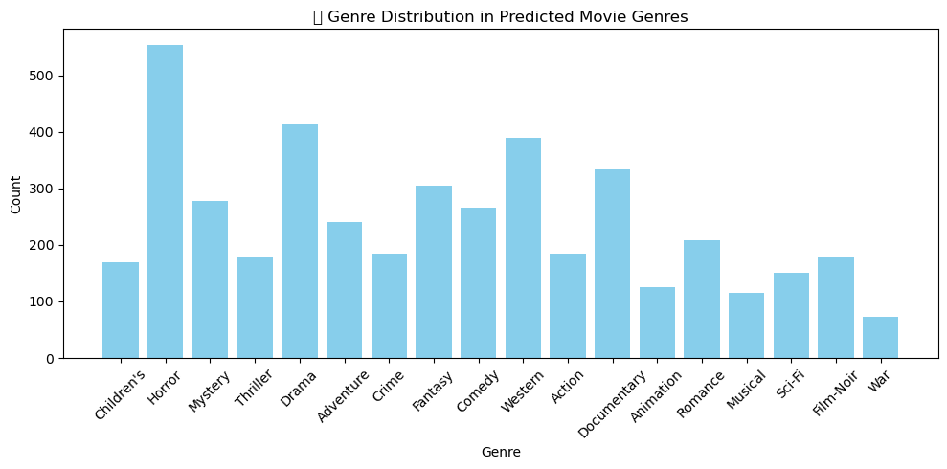
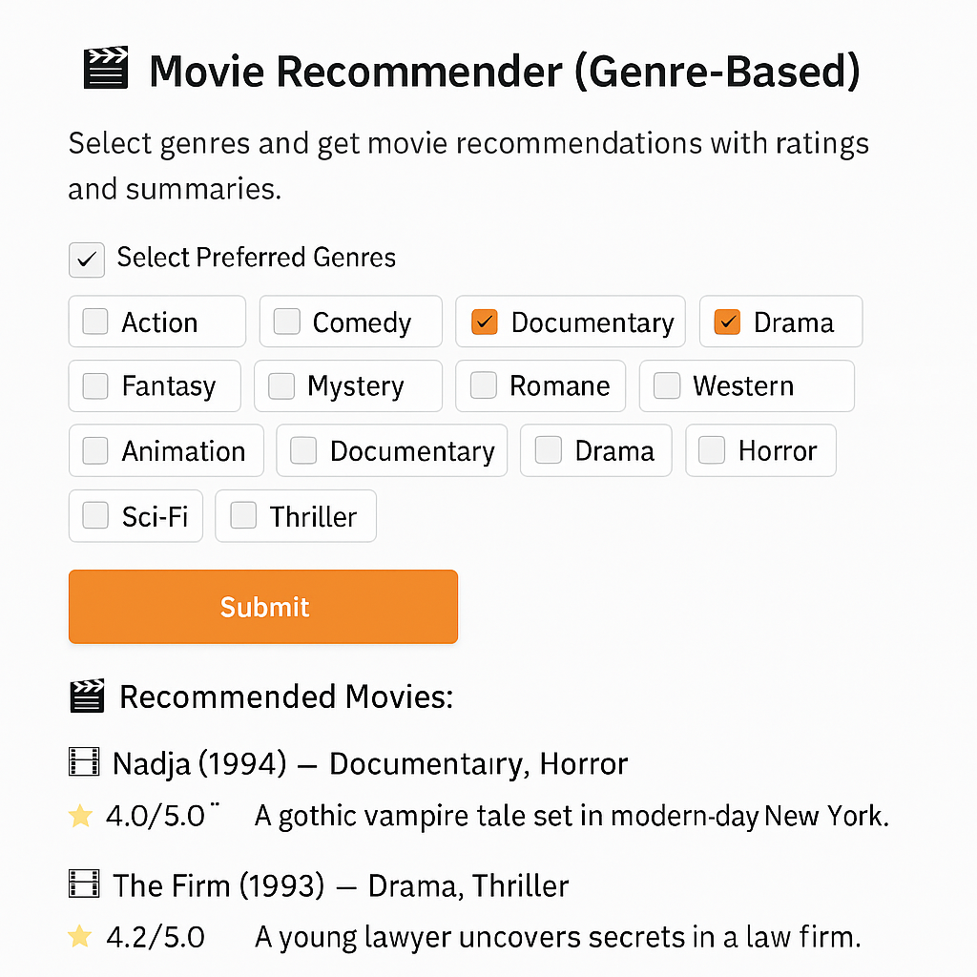
Result & Discussion:
FLAN-T5 generated meaningful and concise movie summaries.
BART achieved accurate multi-genre predictions using zero-shot learning.
FLAN-T5 outperformed BART with higher precision, recall, and F1-score.
Top-5 movies identified by genre preference matched ground-truth data.
Genre-wise trends: Drama, Horror, and Western appeared most frequently.
LIME explanations improved interpretability and user trust in recommendations.

Slide 10
Model Performance Evaluation:
Both FLAN-T5 and BART models were evaluated using the MovieLens-100K dataset.
FLAN-T5 outperformed BART in all metrics:
- Precision: 0.89
- Recall: 0.87
- F1-score: 0.85
- Accuracy: ~92%
BART achieved slightly lower results with an F1-score of 0.82.
Model | Accuracy (%) | Precision | Recall | F1-Score
FLAN-T5 | 92 | 0.89 | 0.87 | 0.85
BART | 88 | 0.84 | 0.81 | 0.82

Slide 11
Conclusion & Future Scope:
Developed a dual-model framework using FLAN-T5 and BART for movie genre prediction.
FLAN-T5 achieved the best results with higher accuracy and interpretability.
The system effectively addressed sparsity and cold-start issues in recommendations.
LIME improved explainability and user trust in predictions.
Future work: apply on larger, balanced datasets, integrate video/audio features, and test
lightweight models for real-time recommendations.

Slide 12
References:
Z. Chen et al., “Collaborative Filtering Network with PMF for Movie Suggestions,” IEEE TKDE, 2024.
H. Liu et al., “Multi-modal CNNs for Movie Recommendation Using Content Features,” IEEE Access, 2023.
Y. Jin et al., “A Transformer-MLP Hybrid Framework for Movie Recommendation,” ACM RecSys, 2025.
S. Longpre et al., “The FLAN Collection: Designing Data and Methods for Effective Instruction Tuning,” ICML, 2023.
S. Raj et al., “Transformative Movie Discovery: Large Language Models for Recommendation and Genre Prediction,” IEEE Access, 2024.

Slide 13
THANK YOU

